Slide 1
Review agriculture & food policies for impacts on organic agriculture

Slide 2
Introduction and context

Slide 3
Why review agriculture and food policies?
Often, national strategies to promote Organic Agriculture (OA) focus on pro-OA policies (and regulations).
However, some general agriculture and food policies can have huge impacts on OA development (sometimes bigger impact than specific OA policies).
A good comprehensive national strategy should review general policies and propose changes to reduce or mitigate their negative effects on the organic sector.
If general policies cannot be changed, specific OA policies can be added to compensate for the negative effects (e.g. new incentives balance out disincentives).

Slide 4
Subsidies on chemical fertilizers or synthetic pesticides

Slide 5
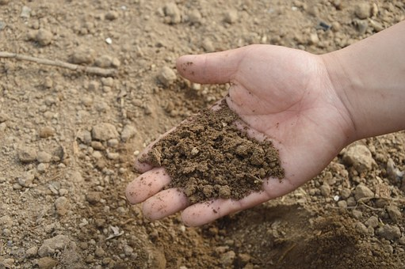
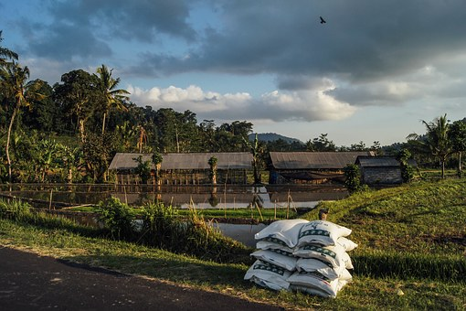
Potential policy problem
If a country subsidizes chemical fertilizers/pesticides but does not equally subsidize organic fertilizers (including those produced on-farm), the incentives work against OA.
Same for reduced VAT for chemical fertilizers/pesticides.
Those incentives to use chemicals in agriculture don’t only discourage OA, they encourage the use of chemicals → negative environmental impact.

Slide 6
Trend of policy improvement
General global trend to phase out chemical fertilizer subsidies and reduced VATs and shift towards the opposite policy instruments.
Taxes on synthetic pesticides and fertilizers and/or preferential fiscal treatment of organic fertilizers and bio pesticides are increasingly adopted.
EU pushing its member countries to make this shift.
Australia, New Zealand or the US do not subsidize fertilizers.
In developing countries, situation still mostly unfavorable to OA. Most countries (especially in Africa, LA and India) still subsidizing only chemical fertilizers, or exempting them from import taxes.

Slide 7
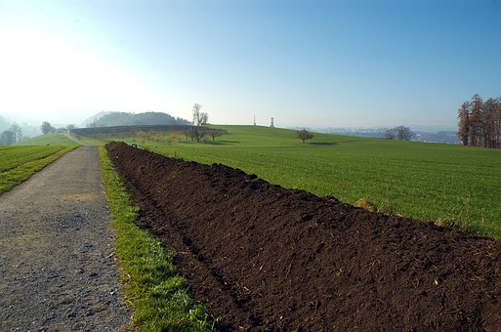
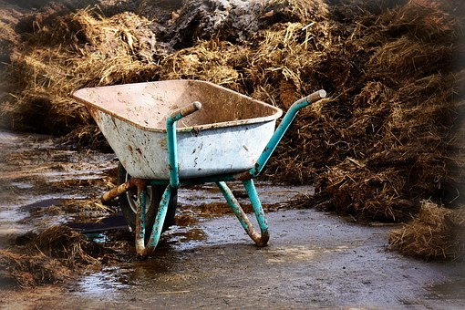
Some good examples
Some EU countries apply lower VAT to organically approved pesticides (e.g. Italy, 4% VAT against 22% VAT for conventional pesticides).
Italy, Germany, France and Austria apply reduced VAT to organic fertilizers compared to chemical ones.
South Korea abolished subsidies to chemical fertilizers in 2005 and is now subsidizing the use of organic fertilizers and soil conditioners.

Slide 8
Bali (Indonesia)
In 2009, Bali government initiated a stepwise approach to phasing out subsidies to synthetic fertilizers and to subsidizing organic fertilizers.
Budget allocated to subsidizing organic fertilizers was gradually increased every year (reaching EUR 700 million in 2014).
Government stopped subsidizing synthetic fertilizers in 2012 and thereafter subsidized only organic fertilizers.
Similar processes in Sikkim (India) and Sri Lanka (started in 2016).

Slide 9
Taxing conventional pesticides (1)
Pesticides have a relatively high price elasticity: price increase (taxes) is an effective way to reduce the use of pesticides by conventional farmers.
Most effective pesticides reduction programs are those that combine tax measure with advice to farmers and regulation (e.g. stricter criteria to authorize pesticides, or mandatory farm-level record-keeping).
Pioneer countries: Sweden, Denmark and Norway who started taxing pesticides in the late 1980s. Programs included also education, extension and research to promote good practices and alternatives to pesticides.

Slide 10
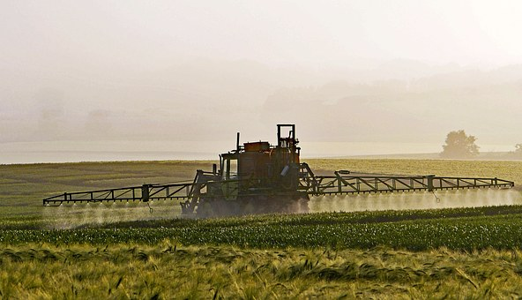
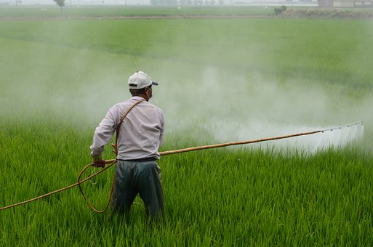
Taxing conventional pesticides (2)
Taxing pesticides can bring substantial revenues to the state (e.g. 2013 in Denmark: pesticide tax revenues was EUR 88 million)
Revenue can be re-invested into OA research and support (e.g. Italy, Denmark, Sweden)
Designing an effective pesticide taxation system is complex → see more detailed resources in the IFOAM-OI Toolkit on Public Support to Organic Agriculture.

Slide 11
Regulations on farm-made and organic fertilizers, plant protection products and farmers seeds

Slide 12
Potential policy problem
Complex registration requirements can make it technically illegal for farmers to use any unregistered pesticide or fertilizer, even if it is biologically based and prepared on farm.
Stringent registration procedures for pesticides are easy for big agrochemical companies to meet, but nearly impossible for small scale producers of organic inputs.
Similarly for fertilizers when requirements for commercial fertilizers demand full exact labeling of nutrient content – can be unfeasible for composts and other natural origin fertilizers.
Organic market is still small: limited economic interest for the companies to develop new organic inputs or varieties or to pay for registration (e.g. nettle decoction).
Notes:
Requirements for labeling of nutrient content: should be based on average values instead.
Limited interest to develop new organic inputs and pay for the registration: E.g. who would be willing to pay for registering nettle decoction as an allowed pesticide? Government should sponsor those kind of registrations which are for products with no intellectual property right.

Slide 13
EU situation
Still mostly unfavorable to organic inputs.
E.g. EU has no differentiated provisions for the approval of plant preparations or micro-organisms as pesticides. Criteria can incentivize purified single-compound botanicals, as opposed to more unrefined preparations.
Process can take years, even if the substance is already approved as food (so obviously non-toxic), e.g. sucrose.
Some efforts to lower the registration fees for microbials in some countries.
Some hope for improvement: in 2016, EU initiated review to propose a simplified system for low-risk substances.
Notes:
In general, the EU, compared to the USA, has higher costs and a slower approval system for organic plant production products to enter the market.
Under current EU regulations, substances need to be first approved in the general legislation before they can be added to the organic regulation list. The process can take years, even if the product is already recognized as food (this is for example currently the case with sucrose as a plant protection substance – stuck in years of registration process).
Microbials: (bio pesticide products made of viruses, bacteria, nematodes and fungi, which are acceptable in organic production)

Slide 14
Registration of non-mainstream varieties
OA uses locally adapted varieties, farmer-saved seeds and old and non-mainstream varieties → no big commercial interest to develop or register those.
Variety registration costs and seed certification costs are too high and procedures too complex for small companies and farmers.
Criteria for variety to be distinct, uniform and stable difficult to meet for old and farmers’ varieties (genetically diverse).
Some countries have specific VCU test (value for cultivation and use) for organic varieties, but some don’t.
Some countries have lower registration fees for organic varieties (e.g. Austria) but most countries don’t.
Compulsory chemical seed treatments can also pose problems.

Slide 15
Policy recommendations
Separate and simplified registration procedures should be developed for well-known low-risk substances with high natural background (e.g. rock powders) and/or commonly used for other purposes (e.g. in food).
Good example: Brazil:
  since 2003 exempts organic fertilizers and pesticides from the classical registration process.
  Government also financed the registration of 50 organic inputs by financing studies, tests and registration applications.
  Law should exempt local & traditional varieties from cumbersome registration and testing requirements (e.g. Brazil), and have simplified and cheaper approval processes for organic varieties.
Notes:
In Brazil, the law on OA relieves family farmers and traditional groups, as well as their cooperatives or association, from the obligation to register varieties in the national registry.

Slide 16
Government-supported agricultural risk management programs

Slide 17
Crop failure compensation schemes
Farm insurance programs give financial compensation to farmers in case of calamities (droughts, animal epidemic, etc.).
Generally a positive thing for farmers, but the compensation modalities can disadvantage organic farmers.
If government-sponsored farm insurance program, make sure it does not advantage conventional over organic farmers, e.g. by:
Applying same price level to organic & conventional crops/animals
Focus only on few commodities (organic farms are more diverse)
Tying crop insurance to certain non-organic practices (e.g. use of synthetic inputs)
Only recognize “natural” disasters and omit GMO contamination as another external cause of market loss.

Slide 18
Allowance of GMO crops

Slide 19
The risk of GMO contamination
Widespread GM contamination is a major risk for a country’s organic sector. Can lead to increased costs, loss of reputation, and loss of market for an organic supply chain.
Solution is “GMO-free region” or country. In 2015, 37 countries have officially banned the cultivation of GM crops.
If GMOs are allowed, then need for GMO co-existence regulations, aiming at avoiding GMO contaminations and compensating farmers whose crops are contaminated (e.g. Portugal where GMO seed suppliers pay into the compensation fund).
If GMOs are allowed to be grown or imported, then there should be at least compulsory GMO labeling for transparency to consumers.
Notes:
Coexistence regulations can be of different nature, including ex-ante (preventive) coexistence regulations, which GM farmers must follow if they want to plant a GM crops, and ex-post coexistence regulations defining liabilities for contamination. Ex-ante coexistence regulations can include, for example, isolation distance (fixed minimum distance between GM and non-GM crop fields of the same specie, imposed on the GM growing farmer) or temporal isolation (differences in corn sowing dates or in maturity class used).

Slide 20
The story of the GM cotton approval in Burkina Faso
In 2006, Burkina Faso legalized use of GM cotton seeds. In 2008, Bt-Cotton was commercially released & widely adopted (in 2011, 70% of the fields).
Agronomic and commercial disaster. In 2015, the inter-professional cotton associations decided to phase out the use of Bt-Cotton seeds.
This episode has done considerable harm to the growth of the organic cotton sector in Burkina Faso:

Slide 21
Food safety and other health requirements

Slide 22
Examples of food safety / health requirements disadvantaging OA
Restrictions on the use of animal manure (related to food-born illness fear).
Over-demanding and inflexible requirements for the design of production facilities, e.g. for on-farm processing. Flexibility required for on-farm processing and small processing facilities.
Levels of contaminants such as TAs or PAs in harvest (present in weeds so higher in organic fields).
Requirements to prevent epizootic diseases (e.g. to keep birds indoors in Japan after the bird flue, prohibition to exchange and spread manure in the fields during foot & mouth epidemics) without compensation schemes for organic farmers.
Mandatory requirements for irradiation or fumigation with materials that are prohibited in organic production.
Notes:
Tropane alkaloids (TAs) and Pyrrolizidine alkaloids (PAs)

Slide 23
Other aspects to consider

Slide 24
Approval of certain pesticides imports and use
Aerial spraying of pesticides (e.g. Egypt before the 1990s).
Compulsory spraying of DDT in Uganda in 2008 to fight against malaria → permanent loss of organic certification status of more than 16,000 organic farms + long lasting impact on the sector:
Notes:
Egypt is an example of a country that had a chemically-intensive approach to pest management in cotton, whereby the government, starting in the 1950s, organized a program of intensive aerial spraying of chemical insecticides three to four times a season. The government’s approach changed radically in the early 1990s, after SEKEM, an organic company, demonstrated the effectiveness of organic pest control.
Each house, in an entire region, received compulsory DDT spraying, and even though the spraying was indoor residual spray, the contamination impact on organic products that are stored in-house after the harvest was significant and expected to last many years after the spraying. Indeed, any detectable trace of DDT on organic products makes their certification invalid for their target market, namely the EU market.

Slide 25
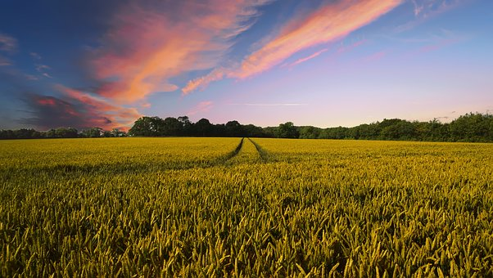
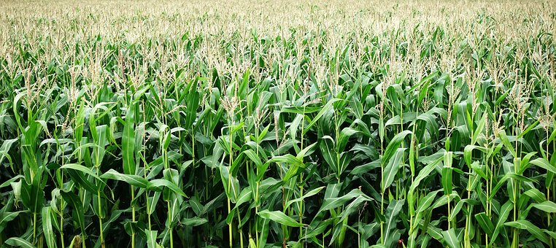
Other issues
Competing environmental schemes (e.g. subsidies for low-pesticide agriculture).
Support for energy crops (biogas and biofuel plants) also competing in land use.
Laws related to farm land access (access to land unaffordable for young farmers, unstable tenancy status whereas OA farmers need to invest in their soils over the long-term, etc.)

Slide 26
Thank you for your attention!
Complete policy toolkit available at www.ifoam.bio

