Slide 1
Public support to organic research and extension

Slide 2
Political justification for supporting organic research and extension

Slide 3
Multiple benefits of organic research
Organic Farming (OF) has a considerable innovation potential, however current spending on OF research does not match this potential.
Organic research can help:
Increase competitiveness of organic operators.
Remove technical obstacles to organic conversion.
Provide evidence of, and quantify, the benefits of organic systems.
Support conventional producers in adopting certain sustainable practices (e.g. IPM).
Notes:
IPM = Integrated Pest Management

Slide 4
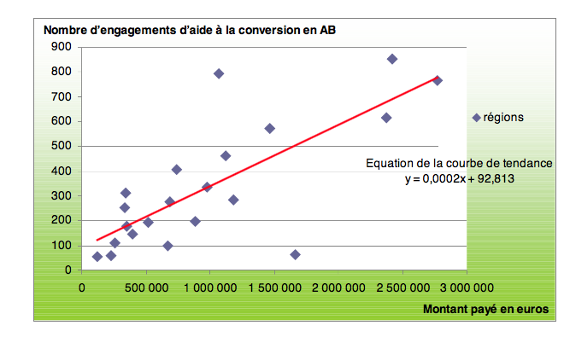
The importance of organic extension
Organic research and extension services should be strongly linked. Farmers’ participation in participatory research is key.
Proven link between government spending on organic extension services and conversion to organic agriculture:
Number of conversions to OF in relation to the amount of funds invested in organic extension.
(Data between 2001 and 2008 per region, in France, ASP, 2009)
Notes:
A study done in France in 2010 (QUELIN C., 2010, Agriculture biologique : La fin du retard français ? ), comparing various regions with very different levels of public spending in organic extension, suggests a strong link between funds invested in organic extension and the number of conversions over the period 2001-2008.

Slide 5
Possible ways to support organic research and extension

Slide 6
Public support to organic research
Organic Agriculture (OA) research integrated within many public research institutes/universities (e.g. Germany) OR
One specialized organic research organization that strongly dominates/coordinates organic research (e.g. Switzerland, Tunisia), OR
Intermediate model: The International Centre for Research in Organic Food Systems (ICROFS), Denmark - a “center without walls”.
Regardless of the model, favor national and regional coordination (e.g. EU-level), partnerships and long-term strategies.
OA research must answer the needs of OA stakeholders, hence stakeholder involvement in agenda setting is key. Traditional and indigenous knowledge should be considered.
Notes:
ICROFS: It is an established organization but operates as a "center without walls," where the research is performed in interdisciplinary collaboration between research groups in different institutions and universities. The lead in organic research can be taken on by a public institution or by a non-governmental institution that receives important public financial support.
Stakeholder involvement: National examples of good public consultation processes and stakeholder involvement in the setting of organic research priorities are Denmark (e.g. for the ICROFS research and development strategy of 2012) and the Dutch research program of WUR/LBI that started in 1993. At the EU level, TP Organics, the European Technology Platform for Organic Food and Farming, is another good example.

Slide 7
Public support to organic extension
Ideal model: OA solutions first, to all farmers, even conventional ones (e.g. Cuba & Bhutan).
Ensure that there is at least one organic adviser per regional/local extension service office.
Government can fund the (organic) farmers’ union to provide organic extension services (e.g. Denmark) or organic training & advice (many EU countries).
Same organization can host organic research & extension services (e.g. FiBL in Switzerland, CTAB in Tunisia).
Special service for farmers willing to convert, e.g. training and advice, phone or email help‐lines, information packages, farm visits, etc. (e.g. “Conversion checks”, Denmark).
Organic Farmer Field School model (e.g. Tunisia, The Philippines)
Notes:
FiBL – Switzerland´s organic research institute FiBL was established in 1974. FiBL is a private research institute, but operating with about half of its budget from public funds. The advisory service of FiBL has coordinated organic extension provision at the national level since 1977, but receives financial support from the regional government
The so-called “Conversion checks”, a concept developed in Denmark, are a full day of dialogue that give the farmer a total overview of what conversion to organic would mean on their own farm: daily practice and routines, solutions to common challenges, special needs for more land or feed, changes to buildings, where to get a contract for organic sales, etc. “Conversion checks” have proven very motivating for the farmer and hugely successful, contributing significantly to a 20% increase in organic land area in Denmark in 2016.

Slide 8
Country examples

Slide 9
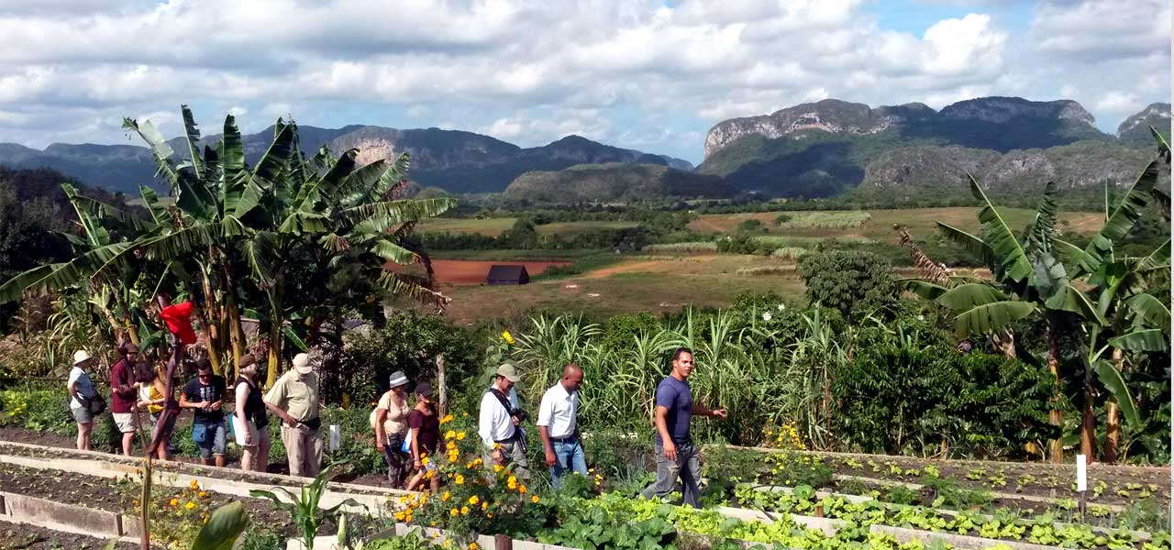
Cuba
Large-scale government support to OA research & extension.
OA in the official agricultural policy in the 90s (embargo).
Leader in many sophisticated experiments and innovations in OA, such as bio-fertilizers or bio-pesticides.
Nearly all agricultural research centers, and agricultural universities have been involved in organic research.
Research and extension deeply interlinked.
Notes:
Cuba is perhaps the best example of large-scale government support to OA research and extension.
Cuba is a popular destination for exchange visits whereby other countries learn about organic innovations that they can replicate in their (tropical) situations, as well as get inspired by the research and extension linkages in Cuba

Slide 10
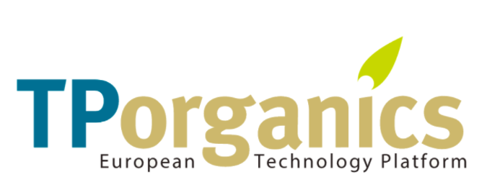
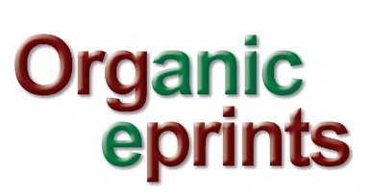
OA research in the EU
Increasing funding to OA research since the 90s:
1990-2006: EU Commission allocated EUR 64.2 million to OA research
2016-2017: EUR 33 million for OA research.
TP Organics, created by the IFOAM-EU group in 2008, is the main mechanism to provide stakeholder input into the definition of the OA research agenda at EU level.
Most agricultural research funds are still managed by EU Member States (MS). E.g.: Germany has the BÖLN federal scheme since 2001 which funded 930 OA research projects for a total of EUR 126 million. Many MS participate in CORE Organic (transnational partnership on OA research) → Organic E-prints
Notes:
Increased funding: The first is a 16 year period. The second is a 2 year period! So the increase is very significant.
TP organic is the European technology platform for organic food & farming, recognized by the European Commission in 2013 and granted official advisory role in the implementation of Horizon 2020.
The German Federal Organic Farming Support Scheme (BÖLN), initiated in 2001, aims at providing information to various actors in the whole supply chain and carrying out research and demonstration activities.
Members of the CORE Organic initiative make their organic research programs findings accessible to a wide range of users through an open access digital publishing archive called organic E-prints as well as through national websites, workshops, conferences, and encouraging coverage of the findings in the (organic) farming press.

Slide 11
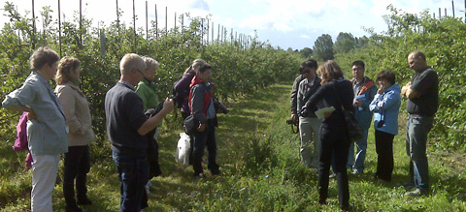
Denmark
≈
Danish Ministry of Agriculture (MoA) established Danish Research Centre for Organic Farming (DARCOF) in 1995 and allocated EUR 13 million for 1996-1999 and EUR 22 million for 2000-2005.
“Center without walls” concept, with ≈ 100 researchers.
In 2008, MoA decided to give an international mandate to the center, which became ICROFS.
Extension is provided by the private sector through the Danish Agricultural Advisory Service and Organic Denmark, with public funding support.
Notes:
DARCOF was a “center without walls” where scientists remained in their own locations while working across institutions (around 20 institutions). The organic farming movement was skeptical towards this concept, favoring an organic institution where capacities could be brought together, and do research in an environment shaped by the organic principles. But the model proved to be a strong model, one that the movement battles to maintain and grow.
ICROFS: The International Centre for Research in Organic Food System.

Slide 12
Tunisia (1)
The government invested considerable public funds into OA research & extension at a very early stage of development of the sector.
The government established several institutions with budgetary autonomy and permanent allocation of public funds:
The Technical Centre of Organic Agriculture (CTAB), and
Regional Center of Research in Horticulture and Organic Agriculture (CRRHAB).
Other governmental bodies involved: Institution of Research and Higher Agricultural Education (IRESA) which created the National Commission for Planning and Evaluation of OA Research.
National Program for Organic Agriculture has organic extension services in various districts. FFS model is being used since 2003.
All the above are cooperating tightly thanks to their institutional linkages (e.g.: membership on one another’s boards and committees).
Notes:
This government investment in organic research and extension institutions with budget autonomy and sufficient funding, as well as their interlinking
is a main factor of the success of the organic sector in Tunisia.
CTAB and CRRHAB were both established in 1999. CTAB adapts the results of CRRHAB’s research for practical application by organic operators in their local conditions. CTAB also oversees trials for the endorsement and registration of different organic inputs and maintains a list of approved inputs on its website.
FFS: Farmer Field School

Slide 13
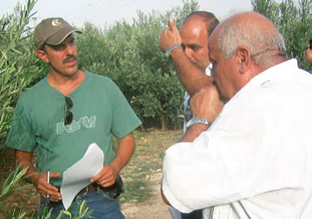
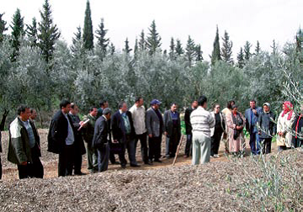
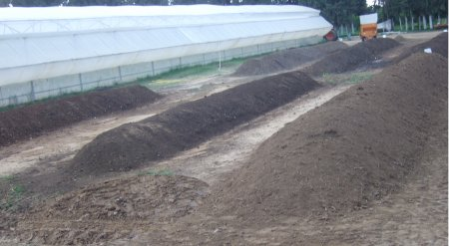
Tunisia (2)
Organic farmer field schools in 2006
Experimental station from the CTAB
Notes:
CTAB – Technical Center for Organic Agriculture)

Slide 14
Pitfalls and challenges of this form of support

Slide 15
Main challenges
Amount and continuity of support.
Right level of stakeholder involvement in establishing research priorities. Not only farmers. Takes time and funds.
Sometimes, bottleneck in the ability of research community to innovate while switching to a different agronomic paradigm.
Not just farming research. Also processing and social & economic aspects.
Comparative research (OA versus conventional) is interesting for advocacy in the long-term but is of little value to OA farmers.
In extension, state of mind of extensionists (who advised for decades on conventional methods) is a main bottleneck: best is to allocated extra resources for for hiring of new staff.
Notes:
Farmers might have diverging priorities with other stakeholders, but all have their legitimacy (e.g. environmental NGOs would be more interested in an optimization of measures to conserve resources and the environment. Farmers on the other hand will be more concerned about solutions for pests and diseases, farm profitability and reduction of labor input. Politicians might push for an increase in farm productivity or farm employment issues).
In terms of organizing the integration of organic agriculture into public extension services, the main challenge remains the state of mind of extensionists in the public system. Some may have the status of public servants (employed by the Ministry of Agriculture) and have life-long positions. If they have been advising on conventional methods for the past 20-30 years, they may be unlikely to welcome a change towards more organic advice (and also are unlikely to be competent in providing this advice). Therefore, inclusion of organic advice in public extension services often means the recruitment of additional staff, and therefore an increase in budget (and not a simple re-allocation of resources to different priorities), at least in the short-medium term until some of the advisors retire.

Slide 16
Thank you for your attention!
Complete policy toolkit available at www.ifoam.bio

