Slide 1
Including organic agriculture/gardening in schools

Slide 2
Political justification for supporting school organic gardening and curricula

Slide 3
Teach Organic Agriculture (OA) benefits early on
School organic gardening and curricula enable teaching kids fundamental lessons about biology, ecology, food and nutrition.
In countries with mainly agrarian economies, school gardens and curricula can start the developmental pathway for acquisition of vocational skills in organic agriculture (teaching future farmers).
Shape the values and expectations of children and their families about organic agriculture systems and food supplies. Effective awareness creation activity.
Notes:
Denmark story in next slide.

Slide 4
Possible ways for policy makers to support OA in schools

Slide 5
Possible policy approaches
Governments can encourage establishment of school organic gardens through small incentives, training, and long-term coordination, enabling school-school exchange learning.
Corresponding organic curricula can be developed and supplied by the government (many global resources available, that can be adapted).
Ideally requires inter-Ministry cooperation (Min. of Agriculture, Min. of Education, Min. of Health and Nutrition).
Organic gardening can be part of the school curriculum or be an after-school activity. Organic vegetables can be eaten in the school kitchen.
Partnerships between schools and organic farmers (government compensates the farmer for their time to show their farm).

Slide 6
Country examples

Slide 7
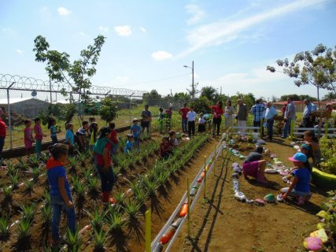
Costa Rica
National Program for School vegetable gardens implemented for more than 20 years.
Government gives financial resources, training and advice for schools to start their own garden project, with strong focus on non-chemical practices, including organic gardening.
Objectives are:
  Supply school canteens with fresh & healthy food
  Promote environmental consciousness
  Develop healthy eating habits in children
  Encourage families to replicate children’s experience with a family vegetable garden for self-consumption.
  Budget is about EUR 254,000/year. 1,000 school projects supported.

Slide 8
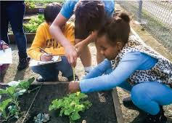
California
“Garden in Every School” initiative created by the California Department of Education.
A 2006 State Bill established a non-competitive grant program to California schools for 2006-2009 to establish, maintain or expand school gardens that are used for academic instruction.
Grants up to USD 2,500 to schools with less than 1000 students and up to USD 5000 to schools with more than 1000 students. 40% of schools applied. USD 10.9 million was awarded.
Funds could be used for equipment, supplies, garden-related professional development.
In parallel, formation of the California School Garden Network.

Slide 9
Pitfalls and challenges of this form of support

Slide 10

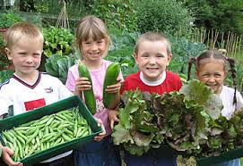
Lessons learned
Slow growth more sustainable than too much too fast. Mutual learning is important (including teachers – pupils – parents – gardening advisers – government authorities).
Integrate gardening, cooking, nutrition and environmental concern education (holistic approach).
In places with long school holidays during the growing seasons it can be a challenge to have someone tending the garden.
Also, it can be challenging to engage/motivate pupils if the harvest takes place after they finish school.

Slide 11
Thank you for your attention!
Complete policy toolkit available at www.ifoam.bio

