Slide 1
Public support to organic farm investment

Slide 2
Political justification for public support to organic farm investment

Slide 3
Investments in organic farms: a key to sector growth
Quantity of private sector investment is key for the growth of any sector, but especially in the organic conversion process.
Conversion requires new machinery, adaptation of livestock facilities, integration of on-farm processing facilities, or organizational investments (e.g. ICS set-up).
Machineries adapted to Organic Farming (OF) are often more expensive due to low economies of scale (technological “lock-in”).
Transition process is also a period of investment in soil fertility and recovering from initial yield drop without organic.
Some conventional sectors are in deep crisis and farmers want to shift to organic, but farmers are too indebted to invest. Small farmers also have too little ability to invest for change.
Notes:
ICS: Internal Control Systems for group certification

Slide 4
Possible ways to support organic farm investments

Slide 5
Incentives for farm investments
Various economic incentives: subsidies, grants, loans with reduced interest rates, tax credits, etc.
On an individual basis (farmers apply individually) or on a collective basis (incentives available to organic farmer groups/cooperatives).
Specific incentives for organic farmers (special organic support program), or preferential access treatment for organic farmers under general agricultural investment support policies, e.g.:
  Higher grants for organic farmers
  Additional points in the grant access criteria formula
  Incentives reserved for certain Organic Agriculture-compatible practices (e.g. livestock housing investments for animal welfare).

Slide 6
Country examples

Slide 7
Ireland
In the period 2007-2013, Ireland has an OF Scheme which combined area conversion and maintenance payments and investment grant-aid for organic farmers and processors.
40% of investments costs reimbursed, to a maximum of EUR 60,000 per recipient for on-farm investments and EUR 500,000 for off-farm investments.
Eligible costs were new equipment and facilities for production, processing, grading, packing, storage, distribution and sale of organic products.
Success of the scheme: OA grew by 30% during 2007-2013. Investment support still exist under another scheme with max of EUR 80,000 per holding.

Slide 8
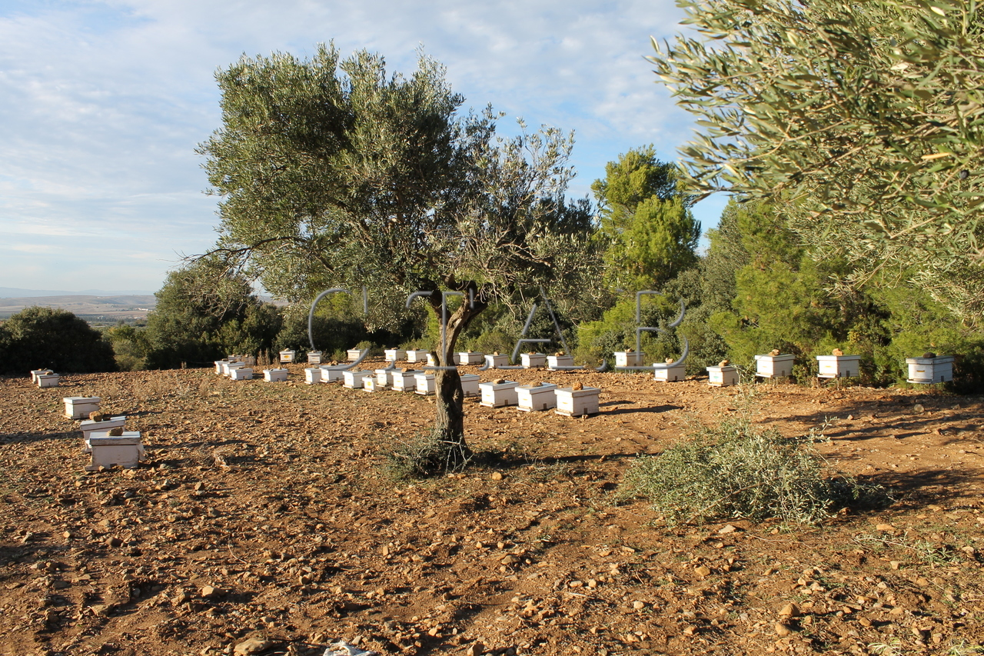
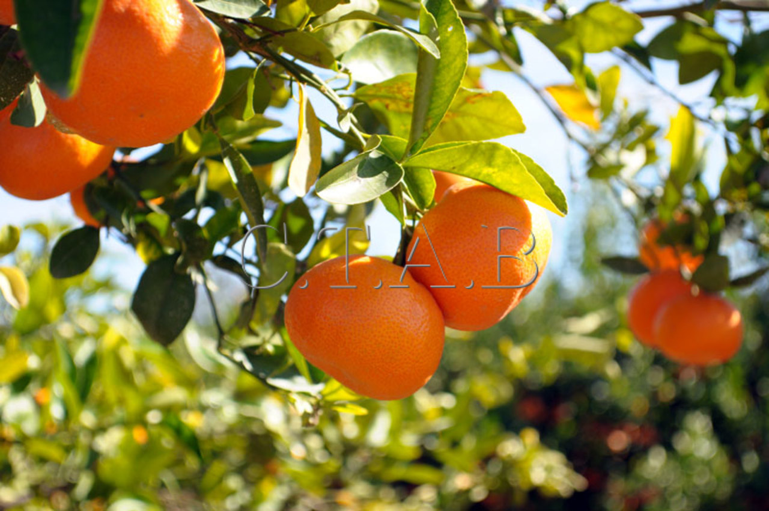
Tunisia
Equipment specific to OF has been subsidized by 30% since 1994.
The Agricultural Investments Promotion Agency also coordinates government investments in the organic sector. By 2010, government had funded 52 OA investment projects worth more than EUR 42 million.

Slide 9
Pitfalls and challenges of this form of support

Slide 10
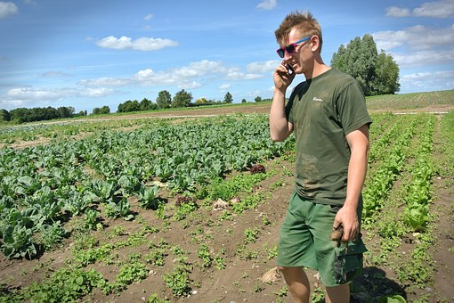
Main challenges
Support true OA conversion, not opportunistic behavior (receiving large investment grant, then returning to conventional agriculture). → Linking support to long-term commitment (e.g. 5 years) or focus investment support on OA-specific machinery (e.g. thermal weeders, compost-spreader, etc.).
Like with other forms of financial support, challenges of producer awareness and ability to submit application (particularly small producers).

Slide 11
Thank you for your attention!
Complete policy toolkit available at www.ifoam.bio

