Slide 1
Public support to develop a national/common organic logo

Slide 2
Political justification for developing a common logo for organic products

Slide 3
A key to fostering consumer trust
Studies have shown that having ONE common organic logo for all organic products is a key tool to build consumer trust and recognition.
Private logos or certifier logos may still be allowed but convey different messages. The common logo = the product is reliably organic.
Can be a national logo (e.g. USDA organic logo) or regional community logo (EU organic logo).
A common organic logo serves the collective interest of organic operators and consumers. Important that it is not controlled by vested interest. Must be a public good.
Notes:
Denmark story in next slide.

Slide 4
Different possible options for the common organic logo

Slide 5
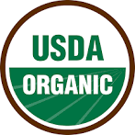
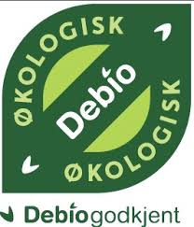
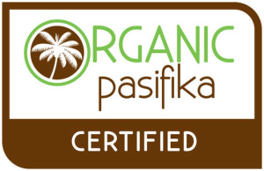
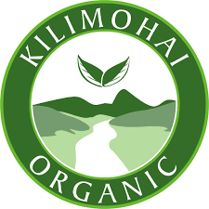
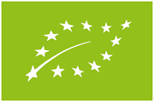
Possible scenarios
Common logo can be linked to a common organic regulation (e.g. EU) or instead to a common non-regulatory organic guarantee system (e.g. East Africa, Pacific Community).
Common logo can be owned by the government (e.g. USA) or owned by the private sector umbrella organization and endorsed by the government (e.g. Norway).
Can be made freely available to operators with comply (e.g. EU logo) or can be licensed to operators with a separate licensing process associated with fees (or not).

Slide 6
Country examples

Slide 7
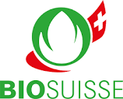
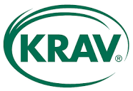
Country overview
Most countries that have a mandatory organic regulation have also an official organic logo developed by the government (e.g. US, Japan, Tunisia, China, Brazil).
Some regional community logos: EU, East-African Community, Pacific Community.
Some countries have a national organic logo without or before having passed a mandatory organic regulation (e.g. Bhutan, India).
A few countries have such strong private organic logos in the market place that they act as de facto national organic logo (e.g. Switzerland, Norway, Sweden).

Slide 8
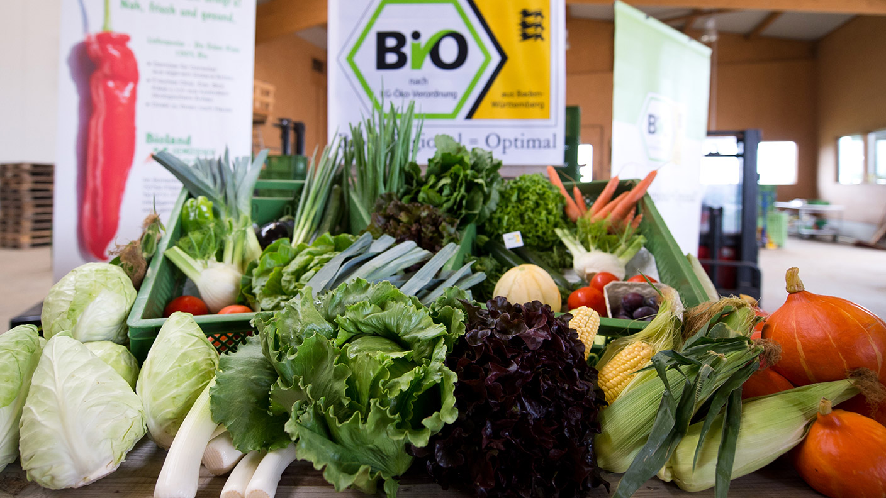
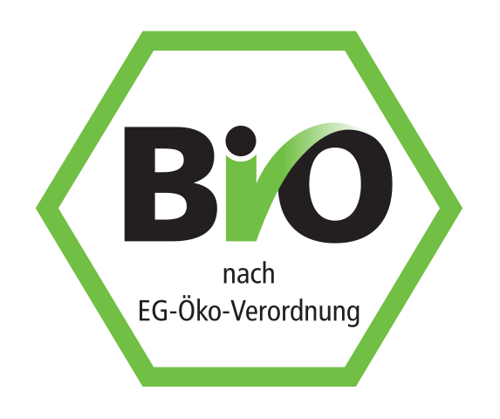
Germany
Germany is largest organic market in the EU. The German Bio-Siegel was introduced in 2001 by the Federal Ministry of Food, Agriculture and Consumer Protection.
German Bio-Siegel = product meets the EU organic regulation.
Voluntary and free of charge for organic operators.
Government spent EUR 15 million to promote the Bio-Siegel to consumers: key of the success of the Bio-Siegel, uptake was high despite being a voluntary label.
Recognized by 90% of the German consumers.
A decade later, German government advocated for an EU-level organic logo, which was adopted in 2010. Bio-Siegel is now phasing out to EU organic logo.
Notes:
Government asked the OPTA to provide the training

Slide 9
Pitfalls and challenges of this form of support

Slide 10
Lessons learned
Think of all possible options and identify the best one (e.g. regional or national logo?).
Territorial scope of the logo should ideally match territorial scope of the Organic Guarantee System (OGS).
Existing logos that have strong market recognition should be kept for a relatively long transition time, to keep consumers.
Several countries attempted to use their national organic logo for export marketing. However, no successful example to date, because products are re-packed or rebranded to focus on importing country logo.
Common organic logo works if it is on ALL (or 95%) of the organic products. Access must be low-cost and easy, included for imported products certified to equivalent standards.

Slide 11
Thank you for your attention!
Complete policy toolkit available at www.ifoam.bio

