Slide 1
Why and how should policy makers support organic agriculture

Slide 2
Why it makes political sense to support organic agriculture

Slide 3
The academic perspective: economic rational
State intervention is economically justified when:
It corrects the negative effects of earlier government interventions (e.g. green revolution push and “agriculture modernization” policies…).
A lack of information severely impedes market functions.
Market failures arise due to the nature of the goods involved such as public goods and externalities.
Markets lead to a socially unacceptable income distribution.
State intervention can also be a national investment to kick-start a sector with high potential (e.g. to establish oneself on the international organic commodity market).
Notes:
Lack of information: e.g. consumers do not know how a food is produced and the potential damages to their health due to pesticide use, etc.
Market failure: e.g. agriculture fulfills many public goods, not reflected in the price of foods.
Socially unacceptable income distribution: e.g. “free” agricultural markets lead to impoverishment of small farmers producing most of the world’s food supply.

Slide 4
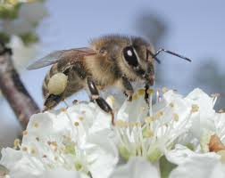
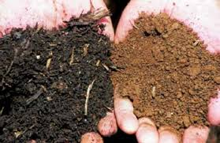
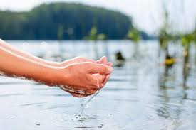
The public goods generated by OA (1)
Environmental protection – ecosystem services:
Biodiversity protection (including of agricultural use, e.g. pollinating insects, pest predators)
Preservation of water quality and less use of water.
Maintains the soil capital for future generations (combat soil erosion, desertification, loss of fertility)
Mitigating climate change through carbon sequestration in the soil

Slide 5
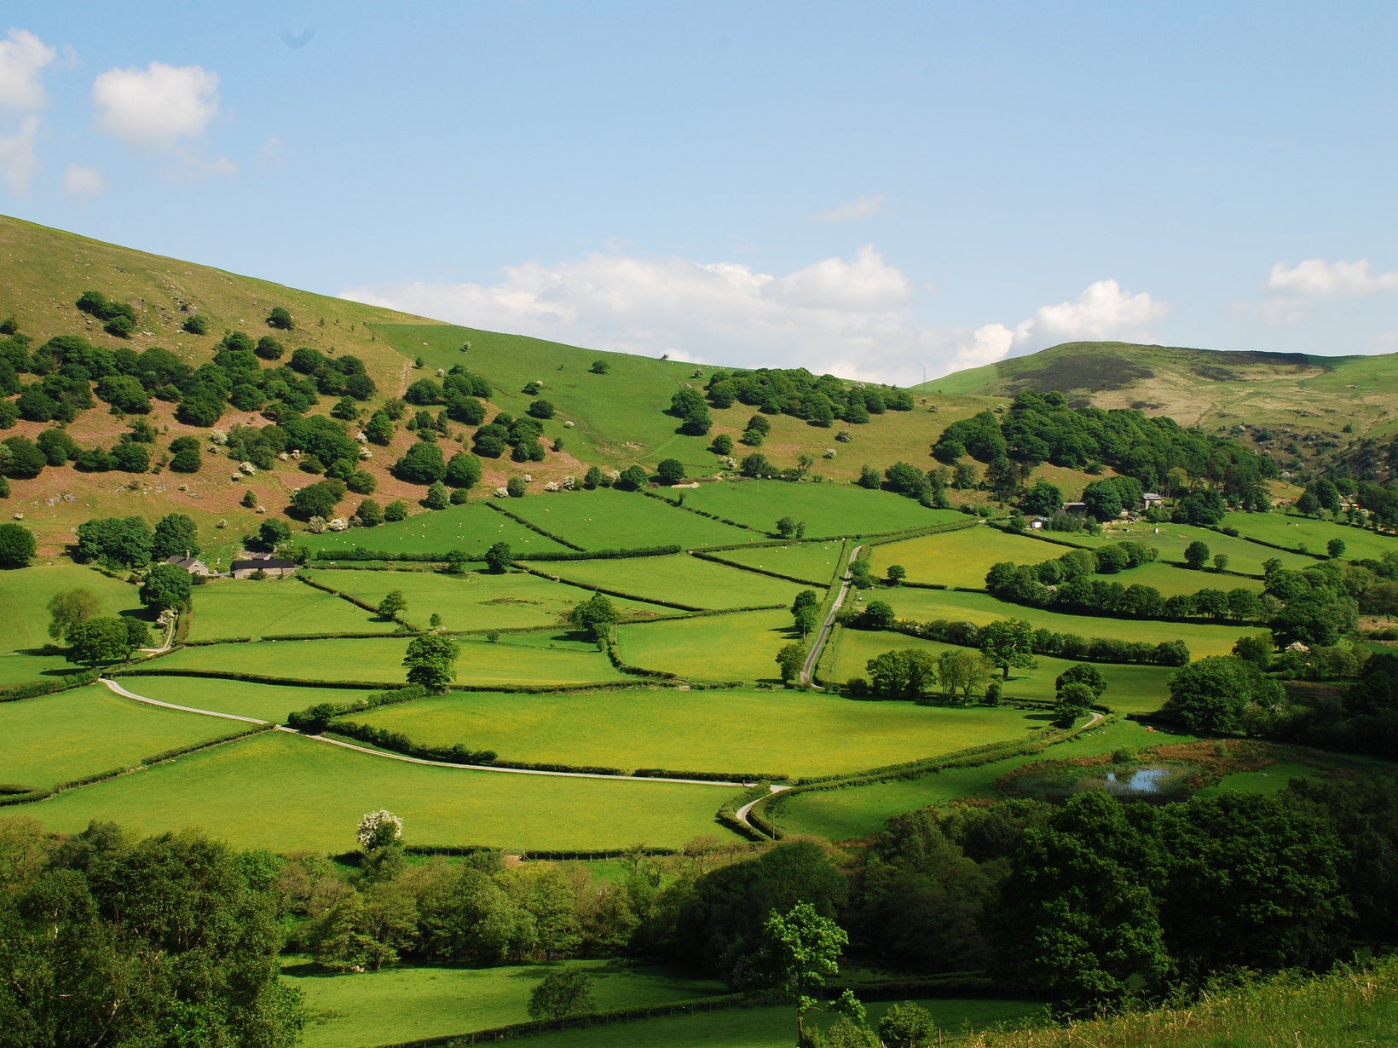
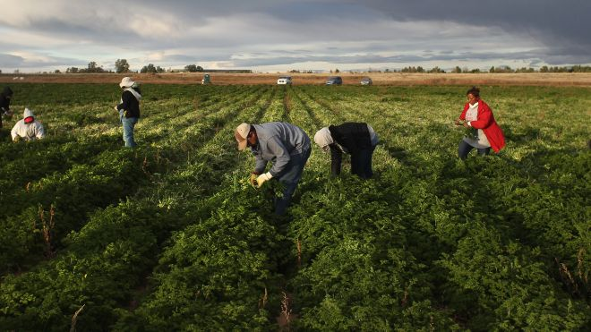
The public goods generated by OA (2)
Rural development and landscapes
Keeps people farming in less favored areas – supports a balanced territorial development and less urban immigration
Preserves beautiful and diverse rural landscapes
OA is more labor-intensive : creates jobs in rural areas

Slide 6
The public goods generated by OA (3)
Public health:
Avoids spreading toxic chemicals in the environment
Protect the health of agricultural workers
Reduces pesticide residues in food
Organic foods are richer in nutrients, anti-oxidants, etc.
Organic production systems offer more diverse nutrition in subsistence farming systems
Notes:
Pesticides impact people’s health, increasing the rate of cancer and other diseases that represent a heavy cost for the public health system and society in general.

Slide 7
Why “subsidize” organic agriculture?
Organic agriculture is “multi-functional”: it produces food and many public goods. The food production function is remunerated by the market. Public goods must be remunerated through other means, primarily public support.
Upcoming concept of “true cost accounting”
+ at early stages of development of the sector, “subsidization is justified by the “infant industry argument”: there are obstacles to transition that needs to be levied, such as farmers’ fear of social exclusion, low economies of scale, lack of organized value chains, lack of knowledge at all levels, etc.
Notes:
Subsidize here is meant in the broadest sense of investing public funds into a sector (whether through subsidies or through other means).
Infant industry: It can take a period of about 20 years of temporary public support in order to invest in research & development, build the organic sector organizations and supporting institutions, and structure the organic supply chain and to achieve mainstreaming of organic products into the normal distribution channels where they become fully accessible to all consumers. Once the organic sector reaches a certain size thanks to public support, self-sustained growth follows, in response to increasing consumer demand.

Slide 8
History and overview of public support to organic agriculture

Slide 9
Role of public support in OA growth
Governments have predominantly supported conventional approaches globally. But in the past 20 years, government intervention played also a critical role in the growth of OA.
In some countries, governments have been the main driver of OA development, either for production (e.g. Tunisia) or for consumption (e.g. Saudi Arabia).
Public support to OA very low in South America & Africa (except Tunisia). Historically low in Asia (except South Korea), but situation recently changing in some states.
USA-EU comparison illustrates effect of policy support: USA 0,6% of land organic, EU 5,7% of land organic.
Support OA started in Europe in the late 80s. Organic conversion & maintenance area payments started in 1994 across the EU. Support to OA in the UE for the year 2001: 520 Million Euros.
Notes:
In Asia, historically the level of support for organic agriculture has been low, except in South Korea. In the past few years, this situation has changed and few states have started to set-up proactive support policies and programs in favor of organic agriculture. One can mention The Philippines, Bhutan, several Indian States (particularly Sikkim, Kerala, and Karnataka), Taiwan.
The effect of public policies on encouraging conversion to organic is particularly visible when one compares the USA and the EU. The USA has traditionally had (and still has) very low levels of public support to organic agriculture. To date, it has converted only 0,6% of its agricultural land to organic – a very poor achievement if one compares to the European Union (with its much pro-active pro-organic policies) that has achieved a total average of 5,7%. And this despite the USA being the biggest organic market in the world (bigger than the EU) and the fact that the market share for organic products is higher in the US than in the EU as a whole).
Additionally, there are very organic-compatible policy efforts underway to phase out agrochemicals and promote organic fertilizers in certain countries, such as Indonesia (Bali) and Sri Lanka. However, in most other Asian countries, the public sector is doing nothing to encourage organic, and this includes the giant Russia but also all the “Stan countries”.

Slide 10
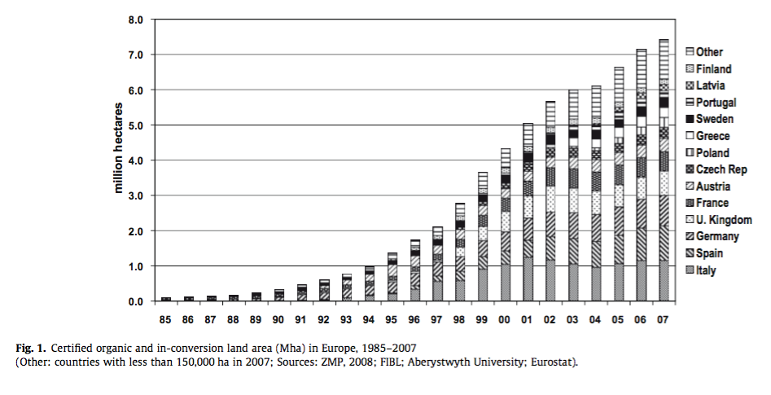
The impact of public support to OA in the EU
Policy matters – a lot!
Start of generalized policy support for organic farming in the EU

Slide 11
How to define appropriate
public support to OA?

Slide 12
Summary of recommendations on policy process
Merely regulating organic is not supporting it. Promoting OA requires other policy instruments than just an organic regulation.
Defining the appropriate policy package should be done through a strategic planning process (outcome: national/regional organic action plan) or similar. May translate into an organic promotion law, a national organic program, an OA national development project…
“Organic” is a concept developed, and driven by non-governmental actors. Design and implementation of policies should always be done in a public-private partnership.
Good organic action plans are based on a deep analysis of the current situation and objective evaluation of previous policy support period to OA.
Effective action plans include SMART targets for OA growth.
Notes:
For organic regulation adapted to various stages of development of the organic sector: see the Organic Regulation Toolkit for Governments, published by IFOAM-Organics International.
Analysis of current situation: e.g. fact-finding study + SWOT analysis done in a participatory way with sector reps.

Slide 13
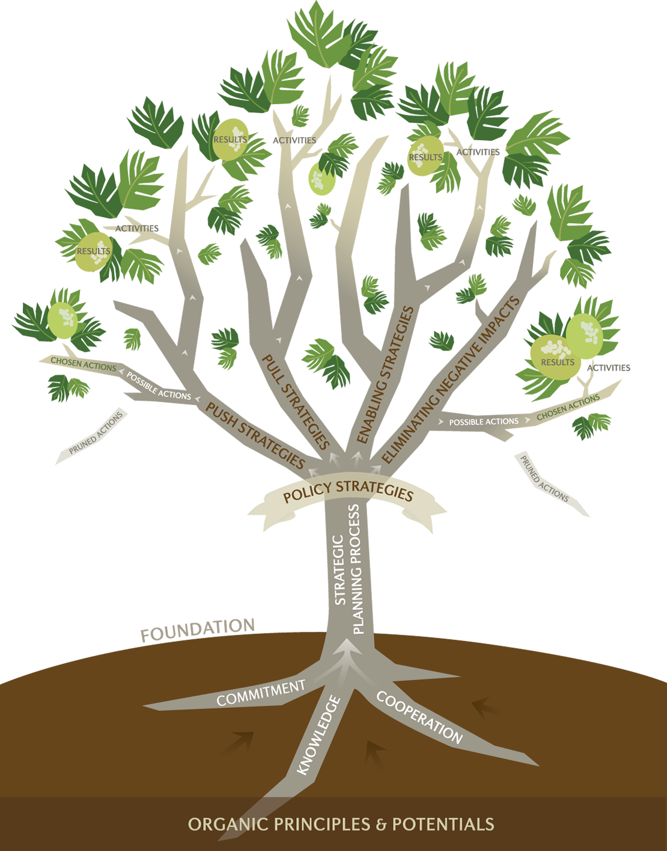
The organic policy tree

Slide 14
Balancing supply and demand
Public intervention will be most efficient when they address the side that is under-developed. But often it needs to address both, to bring the sector to a higher level of demand-supply equilibrium.
Temporary over-production is sometimes necessary to enable economies of scale needed to develop efficient processing and marketing channels.
→ Can be covered through specific support incentivizing farmers to stay organic even if the premium markets are not yet in place.
In a globalized world, supply-demand is no longer a purely national problem. Demand and supply also include international markets. However, sustainability calls for a good domestic balance, whenever conditions allow.
Notes:
Under-developped side: e.g. the production side when there is a supply shortage, and the demand side when there is a supply surplus.

Slide 15
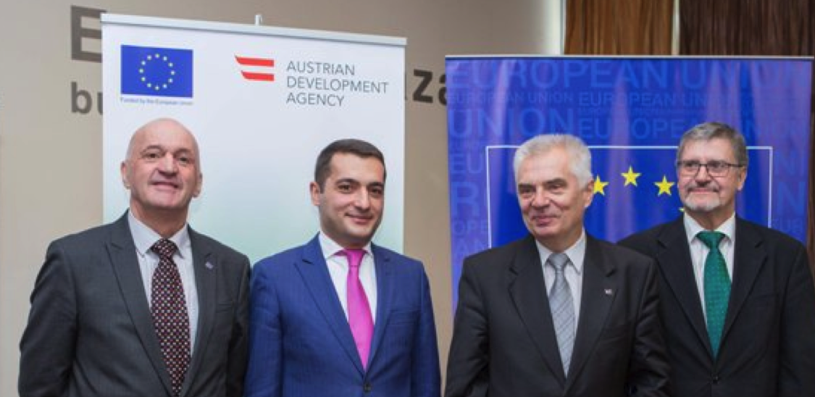
Reliability of government commitment and trust
Visible communication about government policy in favor of organic is a strong support measure in itself: gives signal to private investors.
Private businesses will invest more in organic if they trust the reliability and continuity of government support.
Transitions between multi-year support programs (e.g. between 2 subsidy schemes) is a critical period. Policy makers need to anticipate conversion patterns due to those scheme effects.

Slide 16
Choosing policy measures suitable to the national context
Important factors influence the choice of appropriate measures:
The stage of development of the organic sector (e.g. embryonic …. fully developed sector)
The organic regulatory context (OA regulated or not...)
The culture of government intervention on the agricultural sector (e.g. highly interventionist, or non-interventionist)
Various reasons for policy intervention on the OA sector:
Building an organic export sector (source of foreign currency)
Encourage the production of public goods from agriculture
Increase self-sufficiency in the organic sector (reduce imports)
Facilitate access to healthy foods for all.

Slide 17
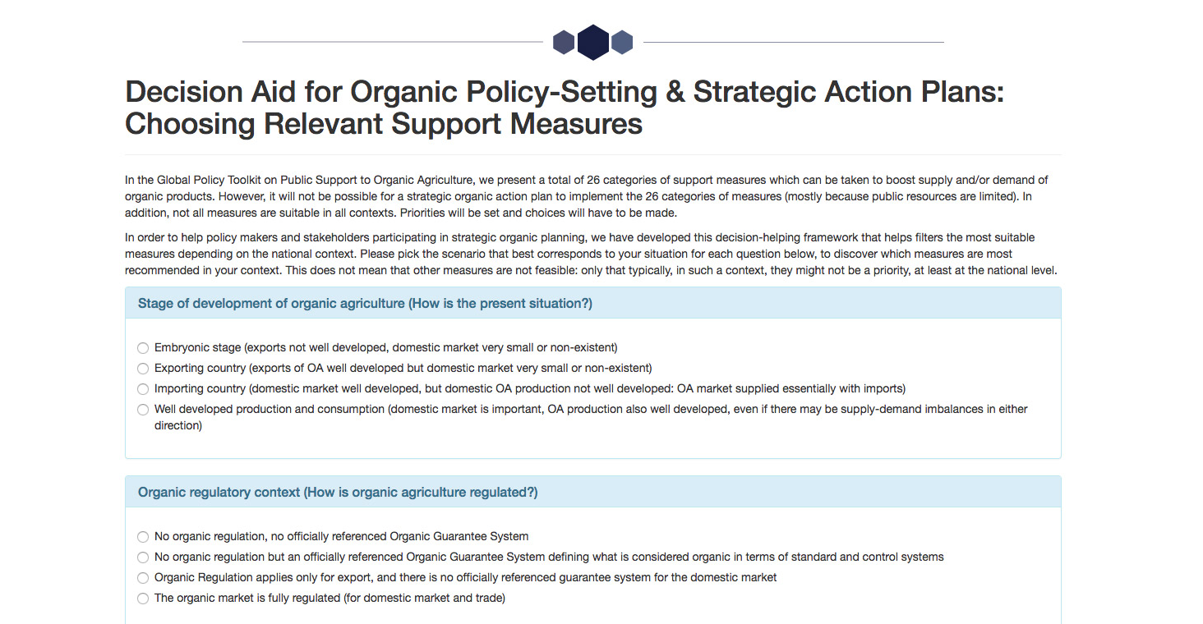
Online decision-aid tool
Decision-aid is an online tool that helps filtering out relevant policy measures based on the combination of scenarios and policy objectives that country finds itself in.
Available on the IFOAM-Organics International website, as part of the Global Policy Toolkit on Public Support to Organic Agriculture.

Slide 18
Overview of possible areas of pro-organic policy intervention

Slide 19
Overview of main organic support measures
Provide financial incentives
Increase technical capacity to convert
Organic Area payments
Support to companies for organic processing, product development & marketing
Push measures:
Tax breaks for organic operators
Support organic research & extension
Support to organic farm investment
Improve organic education
Agri-environmental subsidies
Organic supply chain development projects
Increase availability of organic inputs
Support to certification
Supply side
General enabling measures:
Processing companies decision to create new organic products
Farmer decision to convert
National Data production & dissemination
Stakeholder decisions
which public policies can influence:
Traders and retailers decision to increase organic turn-over
Support the development of organic associations
Support to PGS development
Build organic expertise within public sector
Caterers decision to serve organic food in public canteens
Consumers decision to purchase organic products
Demand side
Promote organic in schools
Public procurement
Common logo for organic products
Export support
Pull measures:
Organic consumer campaigns
Organic Trade agreements
Fostering Domestic demand
Tapping into foreign demand

Slide 20
Overview of push measures
Support to organic research and extension
Support for organic input development and use
Support to certification
Support for organic vocational training and academic programs
Conversion and maintenance area payments for organic production
Support for agri-environmental practices compatible with organic production
Tax breaks for organic operators
Support for organic farm investment
Support for farm income diversification and agro-tourism
Support to companies for organic processing, product development & marketing
Organic supply chain development projects
Organic management in public areas and publicly-owned land
Prohibition of agro-chemical use in sensitive areas

Slide 21
Overview of pull measures
Consumer education and promotion campaigns
Public procurement
Support to domestic trade/ retail uptake
National/common logo for organic products
School Organic Gardening and Curricula
Export support
Organic Trade agreements / equivalence negotiations

Slide 22
Overview of enabling measures (combined push-pull)
National data production and dissemination
Support the institutional development of organic associations
Build organic expertise within the public sector
Support to PGS development
Support to urban gardening and collective gardens.

Slide 23
Some good examples of pro-organic measures

Slide 24
Organic area payments
Subsidy payments per ha available to all organic farmers, for organic conversion and maintenance. Main instrument in the EU.
Strong impact on organic conversion in new EU countries, e.g. Bulgaria:

Slide 25
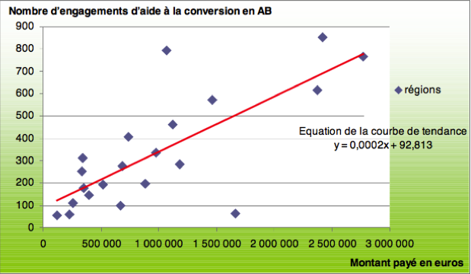
Support to organic extension
French study from 2010 shows clear correlation between the number of conversions to organic agriculture, and the amount of public funds invested in organic extension in various French regions:
—> cost-efficiency of funds spent in organic extension (in the French context) is around 3,000 Euros / farm conversion.

Slide 26
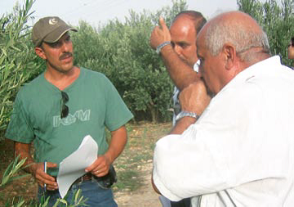
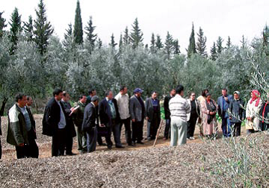
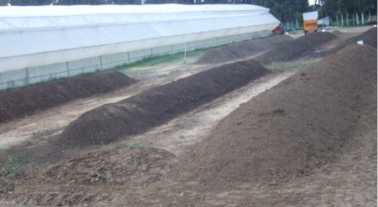
Support to organic research & extension: Tunisian example
Organic farmer field schools in 2006
Experimental station from the CTAB (Technical center for organic agriculture)
Notes:
Tunisia is an example of a country that proactively invested considerable public funds into organic research and extension at a very early stage of development of the sector, with a great success in terms of sector growth. The Tunisian government did so by establishing several institutions dedicated to organic research and extension, namely the Centre Technique de l'Agriculture Biologique ((CTAB) The Technical Centre of Organic Agriculture) in 1999, and the Centre Régional des Recherches en Horticulture et Agriculture Biologique (Regional Center of Research in Horticulture and Organic Agriculture (CRRHAB). The CTAB has been identified as the main driver of Tunisia’s organic sector. It was established through a Ministerial decree in 1999. In addition to those specialized institutions, other governmental bodies are also involved in organic agriculture research, such as the Institution de la Recherche et de l’Enseignement Supérieur Agricoles (Institution of Research and Higher Agricultural Education (IRESA)) which created a body known as the National Commission for Planning and Evaluation of Organic Agriculture Research. More recently, the National Program for Organic Agriculture is setting-up organic extension services in various districts of the country.

Slide 27
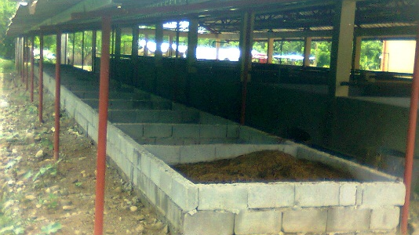
Support for organic input development and use: Example of The Philippines
Vermicompost facility built by one of the Local Government Units in The Philippines
Between 2011 and 2016, the government:
established, maintained and upgraded 746 organic input product facilities.
It distributed more than:
  199,000 kg of organic seeds,
  233,000 planting materials,
  1.1 MT of organic fertilizers and other inputs,
  4.4 million pcs of Bio Control Agents.
Worms given to thousands of households to start on-farm vermicompost.
The government also distributed thousands of organic animals, including organic fish fingerlings and brood stock.

Slide 28
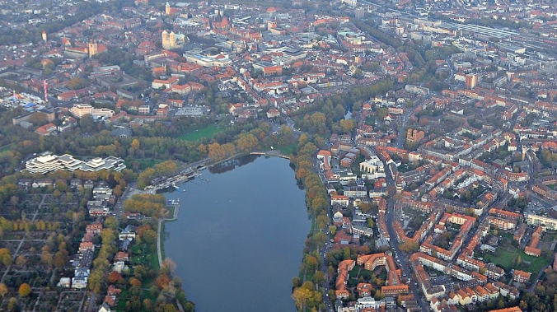
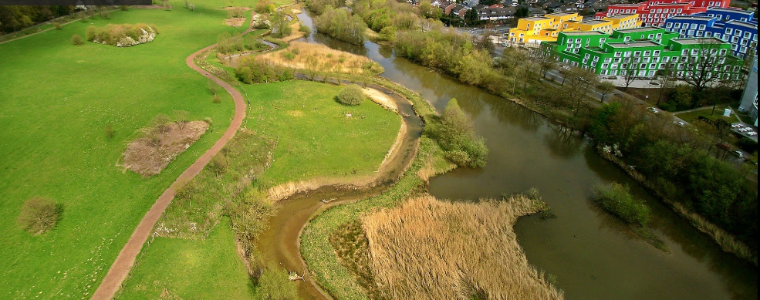
Organic management in public areas (1)
City of Münster, Germany: stopped using synthetic pesticides in green public spaces since 1989

Slide 29
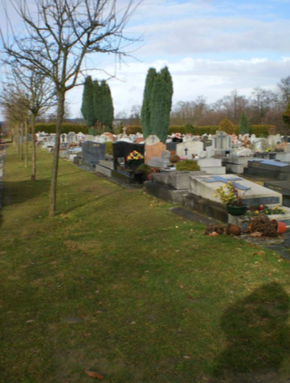
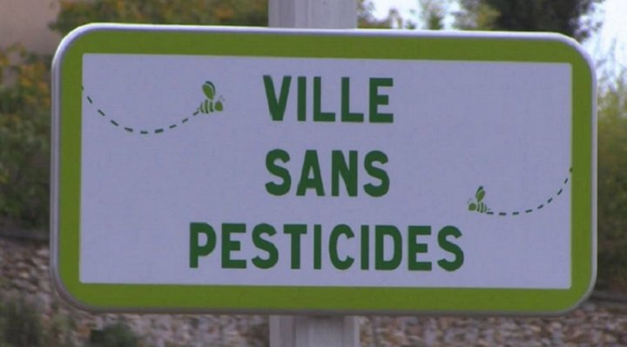
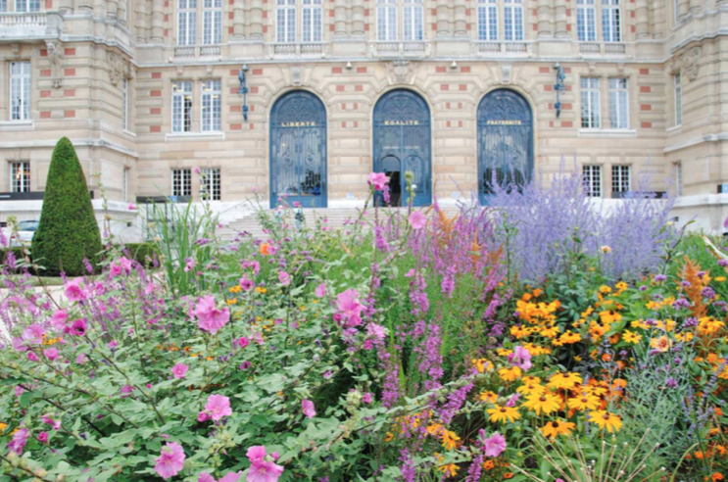
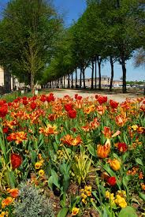
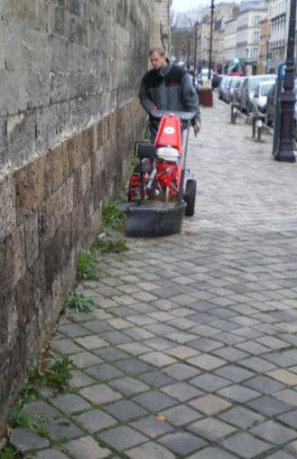
Organic management in public areas (2)
City of Versailles, in France: 86 ha of green spaces to manage, including gardens, lawns, cemeteries. Plus the roadsides. . “Zero phyto” policy adopted progressively from 2002 to 2009.
In France, the government passed a law that will ban the use of all non-agricultural pesticides in all French municipalities (except for railways, roadways and airports) by 2020.

Slide 30
Government support to raising consumer awareness: the Saudi example
The Saudi government financed and co-organized 2 national public awareness campaigns for organic products (total budget 400,000 euros).
First campaign (2011): 180 posters placed in high traffic streets and on digital billboards in shopping malls.
Second campaign (2014), over a 4-weeks period:
A press conference,
4 weeks of “organic food festivals” with big promotion of organic products in in 20 supermarkets throughout country,
Advertisement on digital billboards inside major shopping malls.
Social media campaign
Part of a broader project that also supported the supply side.

Slide 31
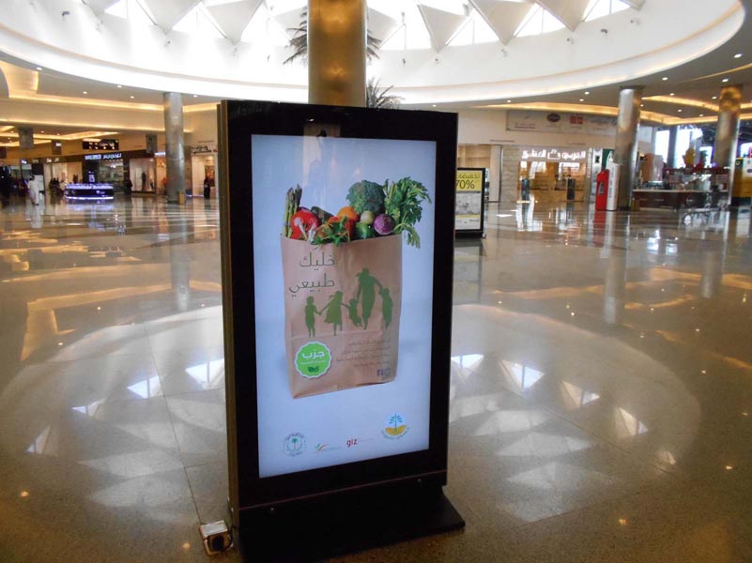

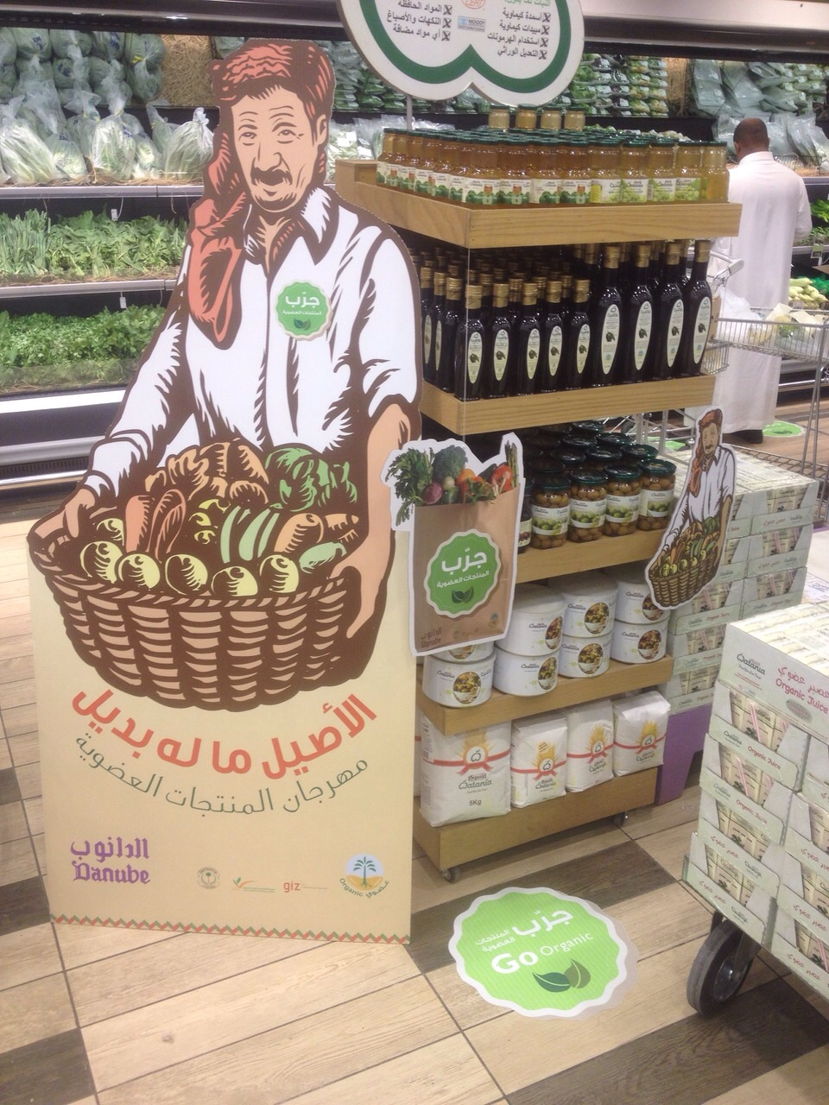
Notes:
Saudi Arabia promotion activities

Slide 32
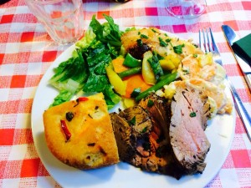
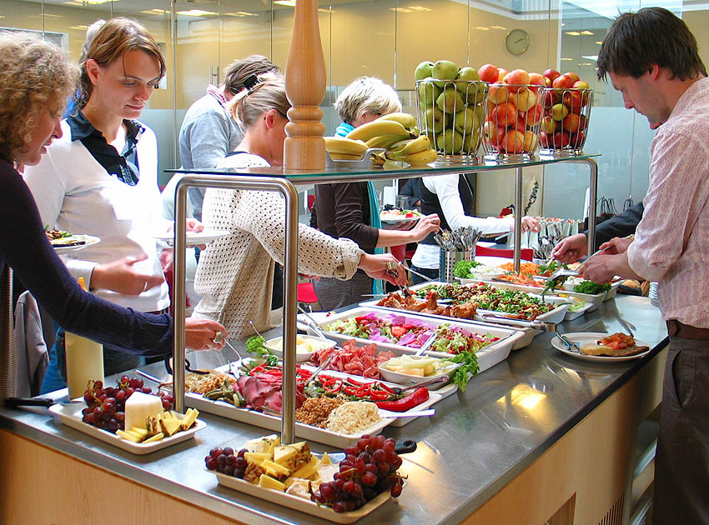
Public procurement:
The Danish example
Copenhagen managed to serve, in its public canteens (20,000 meals/day), 75% of organic food in 2012 and 90% in 2015, without increasing the meal prices.
This is in an overall national effort in Denmark where the government set a goal of 60% organic in all public kitchens by 2020. Almost 8 million Euros allocated to help this transition under the organic action plan for the period 2015-2018.

Slide 33
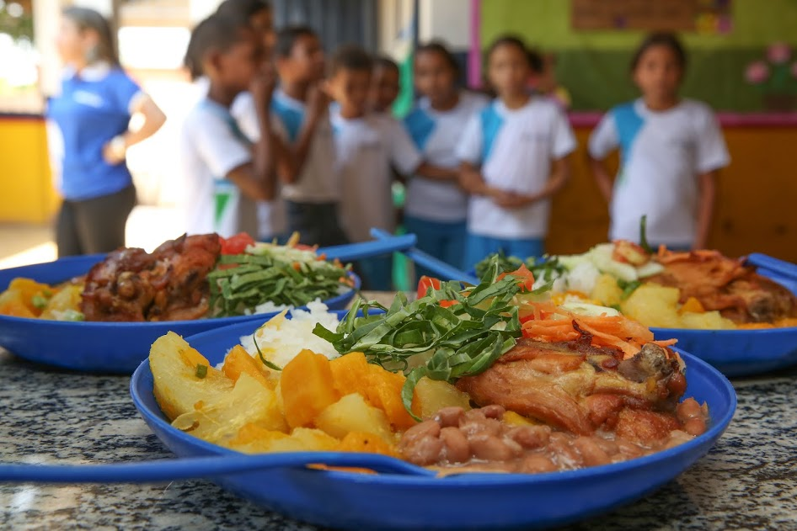
Public procurement:
The Brazilian example
In 2009, the National School Feeding Program (PNAE) sets an objective to purchase at least 30% of the products for school meals from local family farmers, prioritizing organic foods, purchasing to farmers at a 30% price premium.
The program feeds 47 million students each day in Brazilian public schools.
The city of Sao Paolo (12 million inhabitants) passed a decree in 2016 setting a target that by 2026, 100% of the 2 million school meals offered in the city every year should be organic.

Slide 34
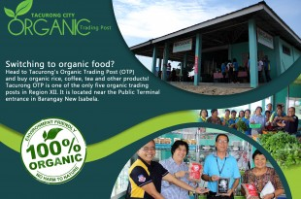
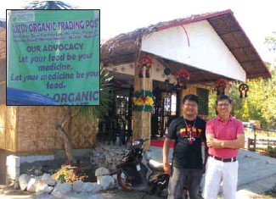
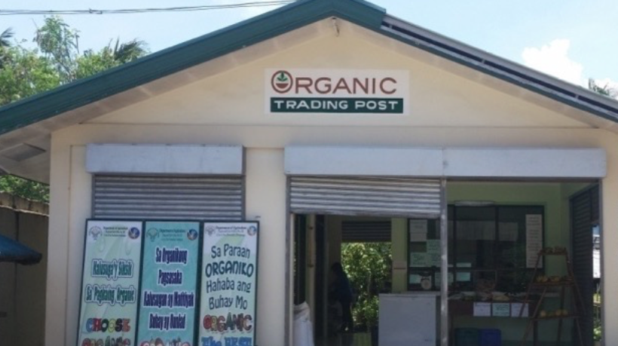
Support to domestic organic retail: example from The Philippines
Government supported the set-up of 72 “Organic Trading posts” (OTP). They serve as organic input and organic retail shops.
Local governments operate the OTP but producers also participate to some extent in the management of the OTP.
National government gave 26,000 Euros per OTP for the building, equipment and working capital and local governments provided land and expenses for operations and maintenance.
Organic Producers Trade Association provided training to the OTP Management Teams on Good Organic Retailing Practices, Organic Enterprise Management, Guarantee System, Finance & Marketing.
Notes:
Government asked the OPTA to provide the training

Slide 35
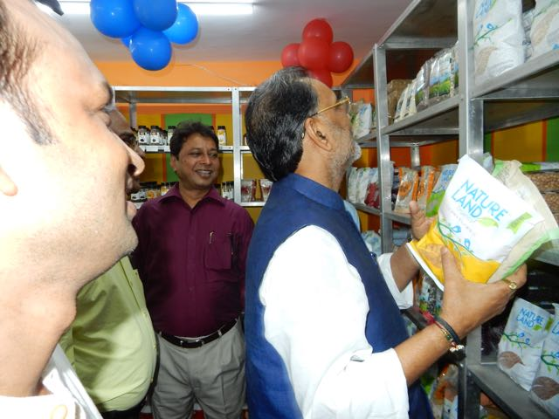
Support to PGS development:
The Indian example
MoA initiated a PGS technical cooperation project with FAO in 2005.
A nationwide PGS development program initiated in 2011 by its National Center for Organic Farming (NCOF). Led to the certification of 21,240 organic farmers through PGS in 2015.
Government vision to reach 200,000 PGS certified organic farmers by November 2017.
In 2016, govt allocated ≈ 40 million Euros to the “Traditional Farming Improvement Program” supporting organic agriculture through a village cluster approach and PGS certification.
Government opens a PGS shop in Delhi in 2016
Notes:
MoA = Ministry of Agriculture

Slide 36
Review obstacles to OA in general agricultural policies

Slide 37
General policies that can impact organic
Subsidies on chemical fertilizers or synthetic pesticides
Approval of pesticides imports and pesticide use
Support for energy crops (biogas and biofuel plants)
Competing environmental schemes
Unfavorable regulations on farm-made and organic fertilizers, plant protection products and farmers seeds
Unfavorable agricultural risk management programs (crop failure compensation schemes, etc.)
Allowance of GMO crops
Food safety and other health requirements
Laws related to farm land access

Slide 38
The story of the GM cotton approval in Burkina Faso
In 2006, BF legalized use of GM cotton seeds. In 2008, Bt-Cotton was commercially released & widely adopted (in 2011, 70% of the fields).
Agronomic and commercial disaster. In 2015, the inter-professional cotton associations decided to phase out the use of Bt cotton seeds.
This episode has done considerable harm to the growth of the organic cotton sector in Burkina Faso:

Slide 39
Thank you for your attention!
Complete policy toolkit available at www.ifoam.bio

